Slide 1

DECODE – 2024 Data Exploration, COnceptualization and DEmystification Statistics Track – Final Round
Sibin V.S., Arshith K., Vidyashankar Iyer
Pondicherry University, Puducherry (India)

Slide 2
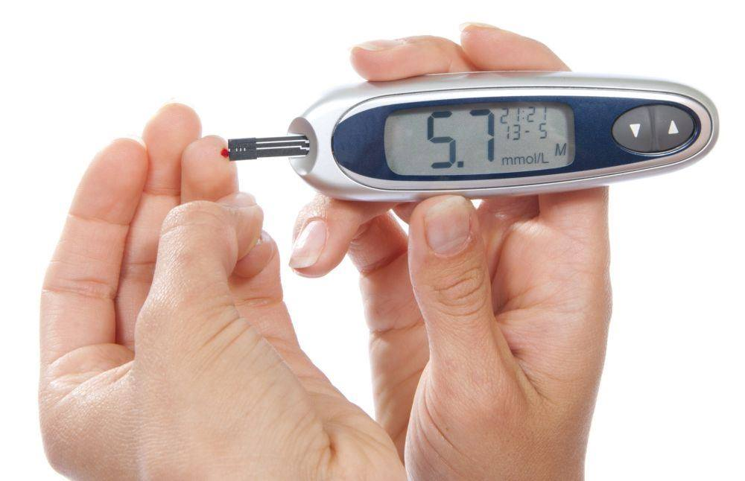
Introduction
The case study was guided by the objective to analyze the efficacy and safety of the drug insula over placebo in patients experiencing Type 2 Diabetes. Today, hundreds of millions of people are living with the disease, putting a strain on individuals, families and our healthcare systems. The need to bring in an efficient solution in handling the disease seems to be worth the hour. Over the past one-month long case study contest on randomized , double-blind ,placebo-controlled, multi-regional clinical trial investigating for the superiority of insula v/s placebo, our team under the guidance of Rashmi Jain and Neha Narendra Mumbaikar was able to bring in critical analysis over the objectives aimed at. With the help of various visualization tools and advanced statistical analysis techniques the conclusions drawn proves worthy. Various analytical tools in – built in R and Python software has helped us in bringing out the valuable results.

Slide 3
Methodology and justification
Data Imputation
Datasets were imputed using Multiple Imputation(MI),LOCF and NOCB techniques.
Primary End Point Analysis
To test for the superiority of insula over placebo on the basis of change in HbA1c level among subjects, we have compared the mean change from baseline HbA1c (i.e., (HbA1c value in week 26) – (HbA1c value in week 0)) for Insula and Placebo over the 26 weeks. ANCOVA model will be used to check whether Insula treatment has a meaningful impact on reducing HbA1C compared to the placebo. ANCOVA treats the baseline HbA1c as a covariate, effectively adjusting for these initial differences in baseline HbA1C level.
The further support to the claim will be analyzed by computing the proportion of subjects turning prediabetic or normoglyceimic during the treatment period of 26 weeks for the two treatment groups.
Visual representations will also be used to validate the findings.
Secondary End Point Analysis
The significance of the treatment methods in the nature of hypoglycemic events is tested by chi-square tests and further the association is proved by visual representations.
Cox Proportional Hazard model (time-event model) is used to understand the significant factors in the occurrence of hypoglycemic events.
SF – 36 Dataset Analysis
The concept of conditional probability distributions in bivariate set up was used in simulating the SF -36 dataset under the underlying conditions. Further, statistical tests were carried out in identifying the significance of differences in SF -36 scores in the domains specified for the two treatment groups.

Slide 4
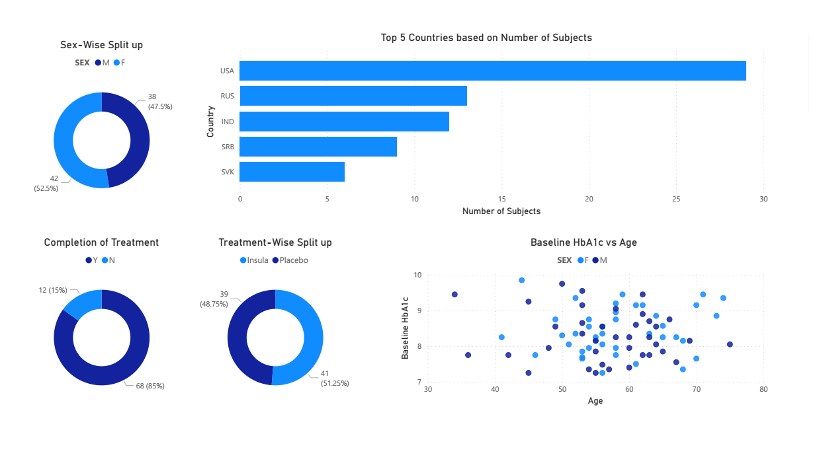
Data Exploration

Slide 5

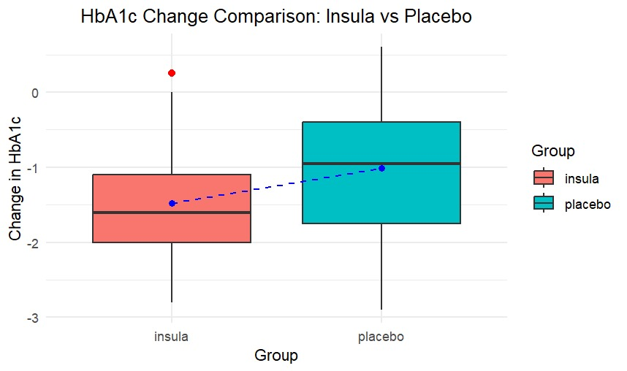

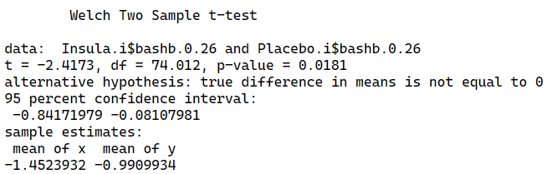
Summary, analysis and visualizations
Primary Endpoint analysis
As the first step to test for the supremacy of Insula over Placebo, we tried to compare the means’ change in HbA1c across the 26 weeks. This change can be calculated by subtracting the HbA1c value at week 26 by the HbA1c value at week 0. Based on the tests, it could be concluded that the mean change in HbA1c is significantly higher than in Insula than that of Placebo. The test results are as follows:
Normality satisfied by the Change in HbA1c under Insula
Normality satisfied by the Change in HbA1c under Placebo
Testing for Difference in mean change in HbA1c due to Insula and Placebo
Data was imputed by multiple imputations (Iterative Imputer) performed in python.

Slide 6
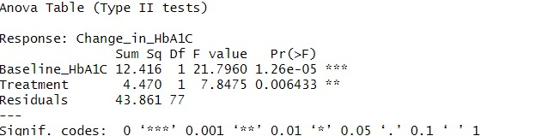


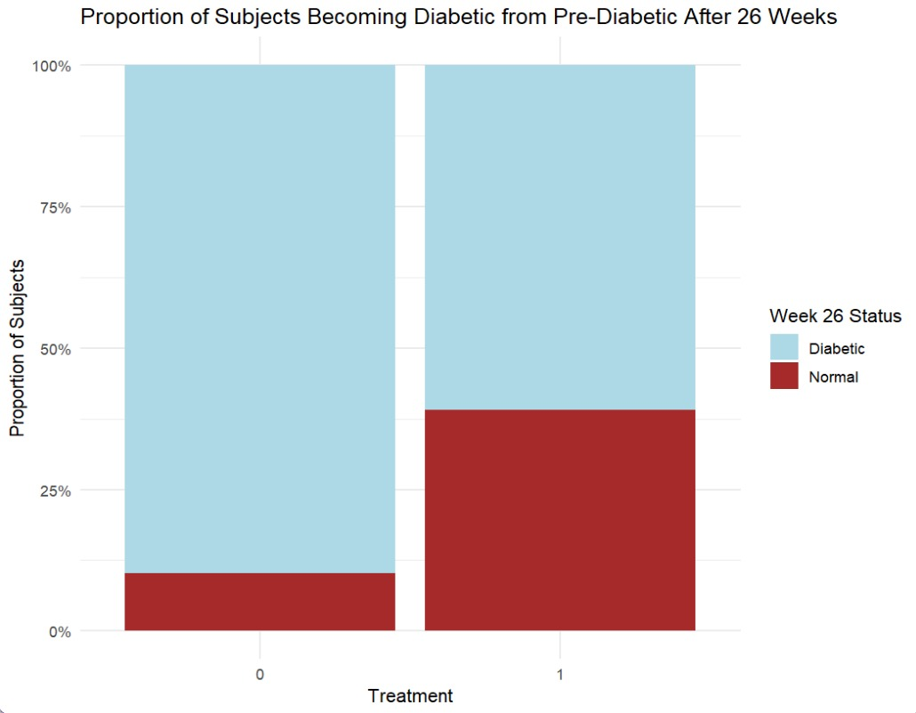
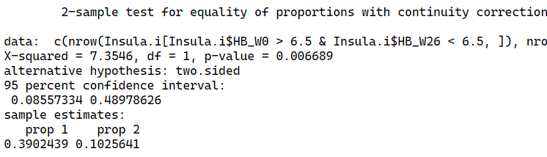
ANCOVA results are given below where the covariate is Baseline HbA1c and fixed factor is the Treatment.
Based on the ANCOVA results we could easily conclude that the mean change in HbA1C values were significantly related by the Treatment and Baseline HbA1C values. The estimated marginal mean change in Treatment groups were -1.458 and -0.985 for Insula and Placebo groups with an estimated marginal difference of -0.473 between the two groups clearly signifying the superiority of insula over placebo in terms of change in HbA1C values over the treatment period.
If we define success as reaching prediabetic or normoglycemic stage, then the success rate in Insula is 39.0% while the success rate is 10.26% for placebo. This marks the superiority of Insula over Placebo.
The claim has been supported by the proportion test.
ANCOVA summary
Estimated Marginal Mean Change in HbA1C for Insula and Placebo over the 26 weeks
Estimated difference of Change in HbA1C between the two groups over the 26 weeks
Proportion test
…

Slide 7
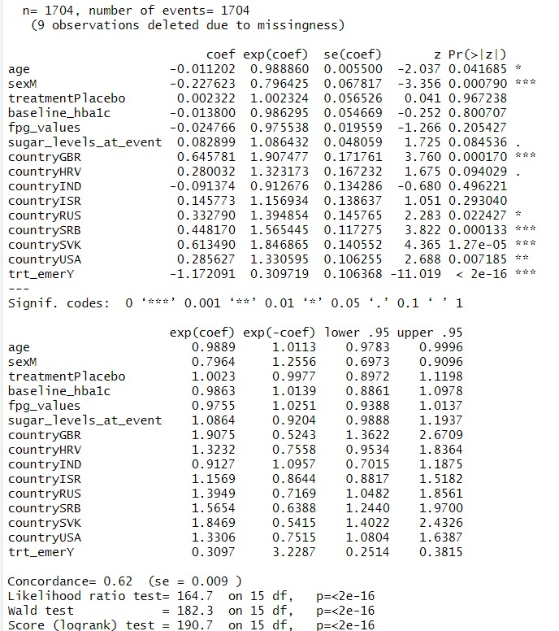
Secondary End Point Analysis
To identify for any patterns or correlations amongst different factors and occurrences of hypoglycemic events, a cox proportional hazard model was proposed and the following factors were identified significant. The results are as follows:
Significant Factors:
Sex: Males have a lower hazard of hypoglycemic events.
Country: Certain countries have higher hazards, indicating
geographical differences.
Treatment Emergent Variable: Shows a significant protective
effect.
Not Significant Factors:
Baseline HbA1c, FPG Values, and Placebo Treatment.
Borderline Factor:
Sugar Levels at Event: Shows a trend towards significance.

Slide 8
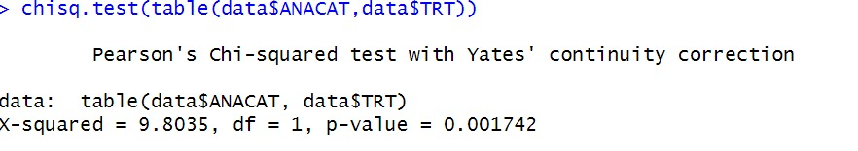
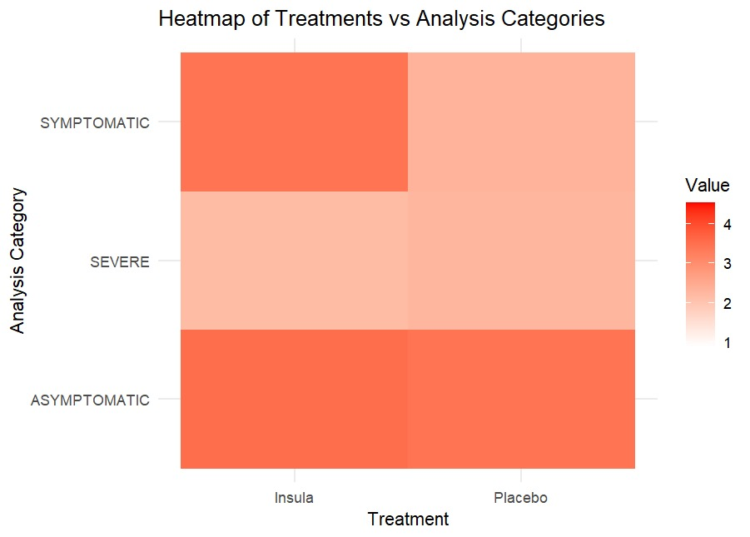
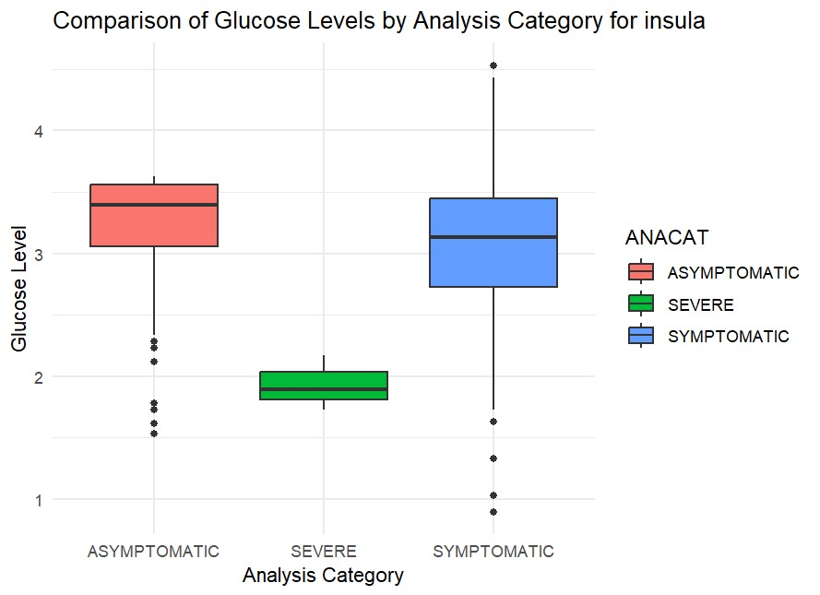
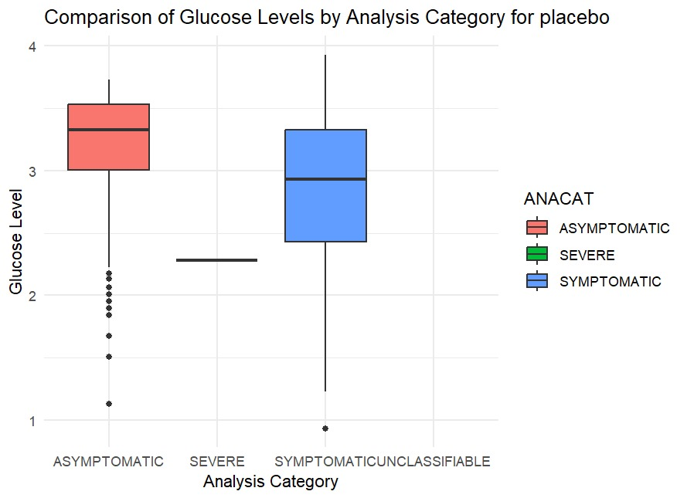
The influence of the treatment on the nature of hypoglycemic event (symptomatic, asymptomatic etc.) was tested using Chi-Square test. The results indicated significant influence of the treatment over the nature of hypoglycemic event. Notably, the insula treatment shows a slightly more consistent pattern across the categories with less extreme variability in glucose levels. Heatmap suggests that there is a high chance of symptomatic hypoglycemic event which is a good sign as the subject can realize his/her situation and act accordingly.

Slide 9
SF 36 Data Simulation and Exploration
Bad sign in this direction
PF
BP
MH
The data was generated by the following method:
Loaded Data in R software.
Computed the mean and standard deviation of HbA1c week 0 or week 26 as per requirement.
Set the correlation with HbA1c, mean and standard deviation of the desired column.
Computed conditional mean and standard deviation.
Generated the column values using the conditional mean and standard deviation along with certain correlation using normal distribution.
Good sign in this direction
SUBJID | Treatment | Physical Functioning (W26) | Physical Functioning (W0) | Bodily Pain (W26) | Bodily Pain (W0) | Mental Health (W0) | Mental Health (W26)
1001 | Placebo | 32.91237 | 47.04638 | 67.2139 | 61.40223 | 50.13174 | 61.3331
1002 | Insula | 35.54133 | 47.26691 | 18.8052 | 41.412 | 60.09684 | 43.79412
…. | …. | …. | …. | …. | …. | …. | ….
1093 | Insula | 70.25045 | 64.14466 | 37.2755 | 54.59197 | 20.51697 | 45.44247
1094 | Placebo | 55.30184 | 43.07866 | 39.09478 | 36.83249 | 36.76779 | 41.3423

Slide 10
Supportive Secondary Endpoint Analysis
t tests were performed to test for the significant change in scores. The results are summarized as below:
Based on the SF-36 physical functioning scores of the subjects under study, about 63% of subjects in Insula group and 33% of subjects in Placebo group experienced clinically meaningful within participant change(>=5 scores). A 0.0136 p-value for a Chi-Square Test indicated a statistically significant difference between the proportion of responders* in the Insula and Placebo groups.
Odds ratio for Placebo: 0.288 (95% Confidence Interval : 0.115 to 0.724)
Hence, the odds of experiencing a clinically relevant change in the SF-36 score are about 71% lower for the Placebo group compared to the Insula group confirming the statistical significance and practical importance of the findings.
FACTOR 1 | FACTOR 2 | P-value | Difference | Difference in Mean
Insula: Physical Functioning (PF) (W0) | Insula: Physical Functioning (PF) (W26) | 0.001147 | Significant | +7.08
Insula: Bodily Pain (BP) (W0) | Insula: Bodily Pain (BP) (W26) | 0.000564 | Significant | -9.08
Insula: Mental Health (MH) (W0) | Insula: Mental Health (MH) (W26) | 0.4965 | Insignificant | -1.80
Change from Baseline PF (Insula) | Change from Baseline PF (Placebo) | 0.005155 | Significant | +8.81
Change from Baseline BP (Insula) | Change from Baseline BP (Placebo) | 0.006464 | Significant | -10.07
Change from Baseline MH (Insula) | Change from Baseline MH (Placebo) | 0.6504 | Insignificant | -1.63
* Responders are those who experienced clinically meaningful within participant change in SF 36 Physical Functioning Score

Slide 11
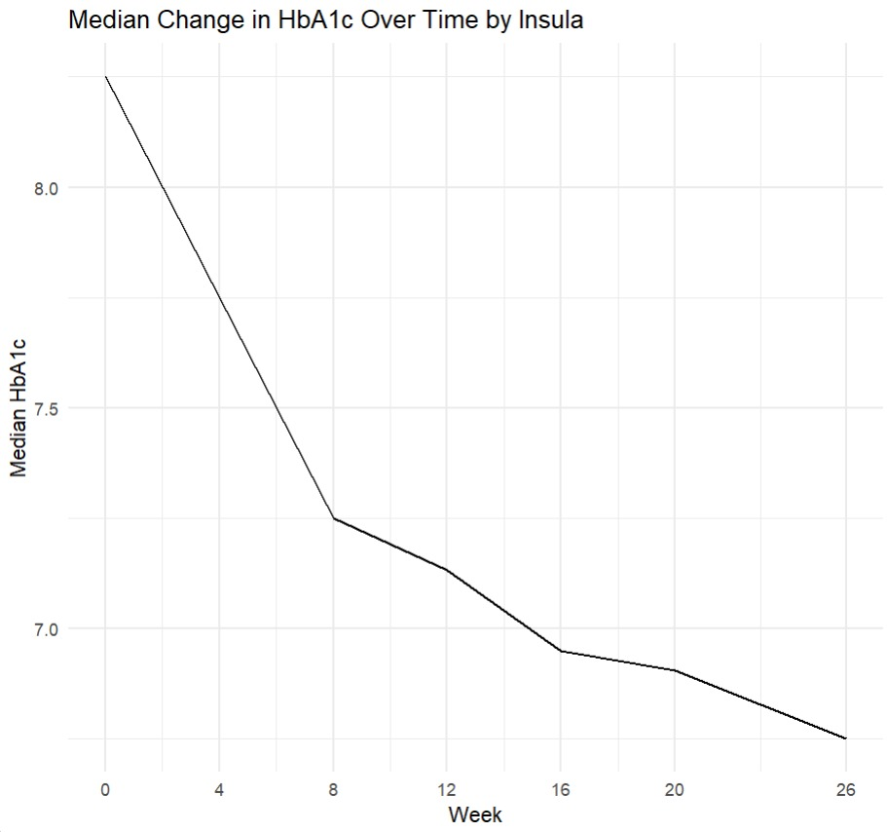
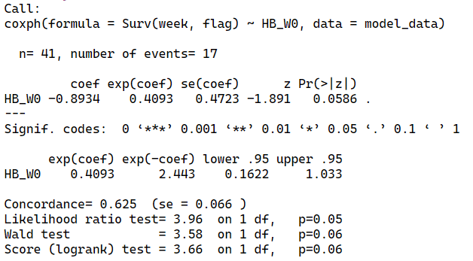
Additional Findings
Issues in data: Duplicate entries for subjects 1033 and 1068 in ADLB dataset, Improper recording start and end dates of the treatment in subject 1092, improper completion flag for subject 1046 in ADSL dataset.
Since Insula was proved superior over Placebo, the week-wise change in HbA1c values were analyzed and the results suggested that the HbA1c reading do decrease with time but the difference is significantly visible only in the first 8 weeks and thereafter the decrease isn’t very significant.
A cox proportional hazard model that could predict the week when the subject could be detected as prediabetic for the first time. Model has a moderate predictive power with overall significance and border level significance of HbA1c in prediction

Slide 12
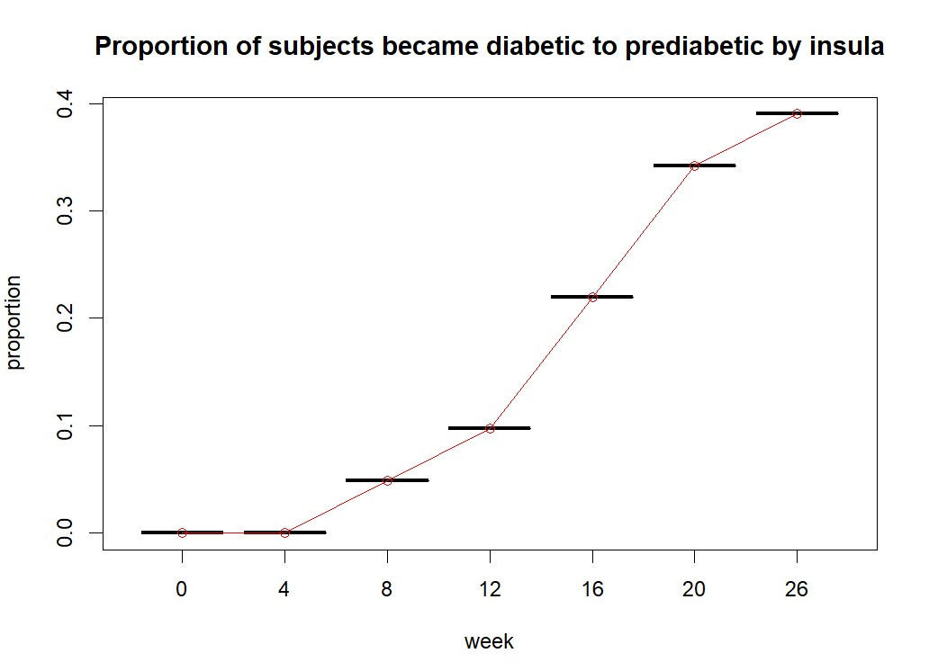
Explanation/Conclusion/Interpretation
In this double-blinded, controlled, and multicenter clinical trial of Insula involving 91 subjects randomized 1:1, the drug Insula was shown to be far more effective than Placebo in reducing HbA1c levels over 26 weeks. Subjects taking Insula experienced an average reduction of 1.5 units from their baseline HbA1c, outperforming those on Placebo.
Notably, 39% of the Insula group were found to be prediabetic during the study. Insula had a notable effect on the nature of hypoglycemic events. Subjects in the Insula group were more likely to experience symptomatic hypoglycemia, which is beneficial as it allows individuals to recognize and address their condition promptly. Additionally, the treatment also led to significant improvements in physical functioning, as reflected in higher SF-36 scores.
However, while Insula's effectiveness was most pronounced in the first 8 weeks, the rate of improvement slowed down afterward. A noticeable increase in body pain, which could interfere with physical activities, was observed as a side effect.
In summary, Insula is an effective treatment, though the potential for increased body pain domain should be considered.

Slide 13
References
https://www.ncbi.nlm.nih.gov/pmc/articles/PMC4933534/
https://www.ncbi.nlm.nih.gov/pmc/articles/PMC5560685/
https://www.ncbi.nlm.nih.gov/pmc/articles/PMC9368172/
https://www.ncbi.nlm.nih.gov/books/NBK554821/
https://www.sciencedirect.com/science/article/pii/S2212109921001564#:~:text=Negative%20binomial%20regression%20analysis%20was,compared%20with%20a%20Poisson%20regression
https://diabetesjournals.org/care/article/30/4/890/25732/Effects-of-Vildagliptin-on-Glucose-Control-Over-24
https://karger.com/pha/article/86/1/44/271974/A-Meta-Analysis-of-Placebo-Controlled-Clinical
ChatGPT, Gemini and other AI Chatbots.

